Slide 1

Project 1 : The cloud network: security analysis team : rootshell

Slide 2

Agenda
Introduction
The Project
  The Network Architecture OJAS
  The Vulnerabilities SHUBHAM
  The Threats and Case Studies SACHIN
  Best Practices NIGAM
  Improvements/ Suggestions SHUBHAM
The Project Learnings and User Stories
  Working with AI tools SACHIN

Slide 3
INTRODUCTION
Confusion
The deliverables responsibilities split but…
Not sure what to analysis- real network/ imaginary??
Sorting
Division of Works
Each person studying the main concepts related to their own deliverables
Conclusion
Finalizing
Each contributed his part to the original network proposed in the “Main report file”
Who to do what at the beginning
Which AI tool and how to use
Each to his own “domain
Setting uo the Backlog file with task splits, deadlines and tracking
The introduction, Improvement suggestions were added based on collective research.
Shaping
Getting in the grooves
Ojas the product owner defined which type of cloud network we will analyze
Each researcher then aligned his research to this network.
Deadlines were discussed and reassessed based on the relaxation of time-line
Executive summary file prepared by AI!
Ojas Pande: Scrum Master and Network Architecture Researcher “OJAS”
Shubham Gupta: Product Owner and Vulnerability Researcher- “SHUBHAM”
Nigamananda Kandulal: Overview and Best Practice Researcher- “NIGAM”
Sachin Wakaley: Threat Analysis Researcher –”SACHIN”

Slide 4
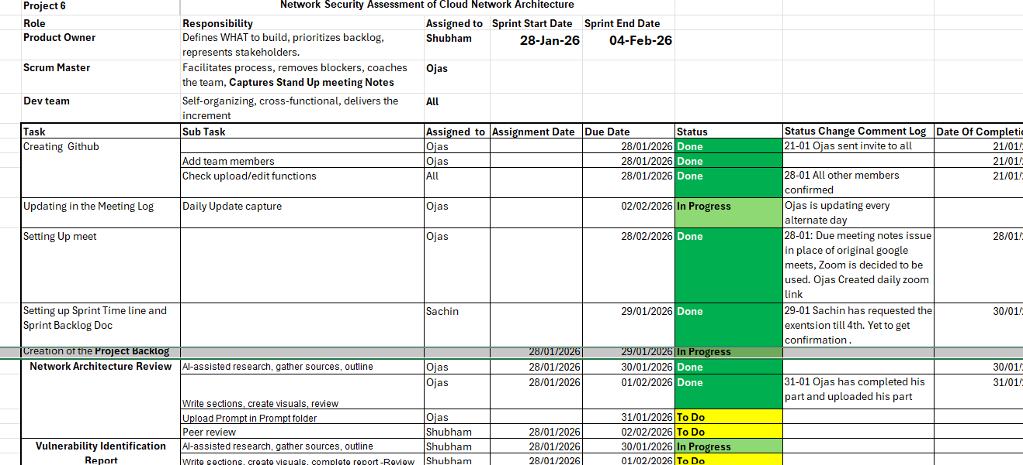
INTRODUCTION
Confusion
The deliverables responsibilities split but…
Not sure what to analysis- real network/ imaginary??
Sorting
Division of Works
Each person studying the main concepts related to their own deliverables
Conclusion
Finalizing
Each contributed his part to the original network proposed in the “Main report file”
Who to do what at the beginning
Which AI tool and how to use
Each to his own “domain
Setting uo the Backlog file with task splits, deadlines and tracking
The introduction, Improvement suggestions were added based on collective research.
Shaping
Getting in the grooves
Ojas the product owner defined which type of cloud network we will analyze
Each researcher then aligned his research to this network.
Deadlines were discussed and reassessed based on the relaxation of time-line
Executive summary file prepared by AI!
Ojas Pande: Scrum Master and Network Architecture Researcher “OJAS”
Shubham Gupta: Product Owner and Vulnerability Researcher- “SHUBHAM”
Nigamananda Kandulal: Overview and Best Practice Researcher- “NIGAM”
Sachin Wakaley: Threat Analysis Researcher –”SACHIN”
Notes:
Shubham: We decided to select Cloud Network project as collectively we had least domain knowledge of this topic. Since myself and Ojas have little bit back-ground I was selected as the Scrum master and Ojas as the Product Owner with all of us as responsible for one deliverable each.
Ojas: As a product owner, however how do I identify which goals individual should work for in parallel? I mean- there are so many different types of cloud network and it was not clear if we have to stick to a particular network/ particular type of network. Team in the beginning started working individually either on the whole subject matter or particular deliverable in a generic way with AI tool.. There was a possibility of mismatch.
Sachin: I did not have cloud network background and my previous working with AI tool was confined mostly to Copilot and here in the course it was explained beautifully how to use prompts and how to generate prompts or what are the different AI tools. For e.g. Claude may be good for research and it produced a report of 70 pages only on Network Security- but the architecture it considered was vastly different than what Ojas was considered in this draft report when we came together in standing up meeting.
CLICK to NEXT SECTION SORTING:
Shubham: With little bit background research done by each we re-assessed and decided to have template for our review for Standing up meeting.
Click for the Template.
Shubham: We broadly divided the deliverables n different sub tasks and set up status as well as deadline-completion columns.
Click for next Stage: Shaping
Ojas: I proposed we take up simplest case of a Single Cloud Network and gave a Network architecture with a review for the others. It helped others to concentrate and then do research specific to this network architecture then.
Shubham: Based on the weekly feedback from Futurense team we also re-aligned the completion date and had daily meeting for a while to see if we are on target.
Click for Next section

Slide 5
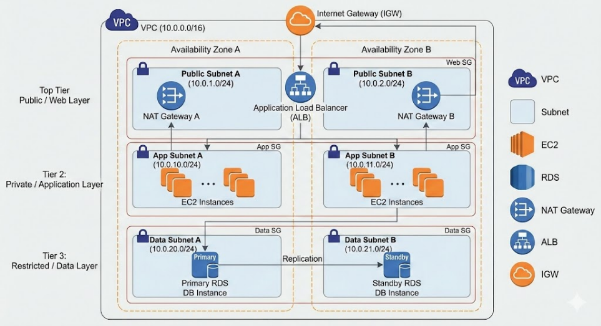
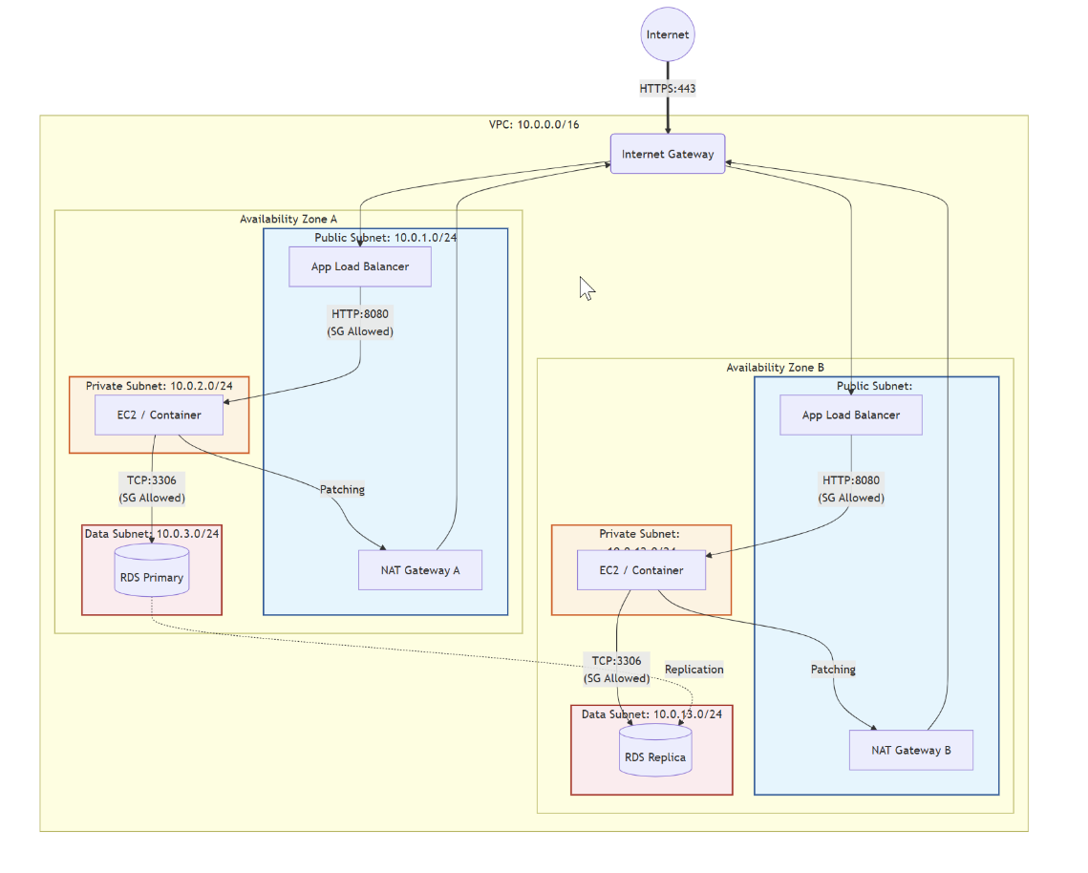
The network architecture

Slide 6
Vulnerabilities

Slide 7
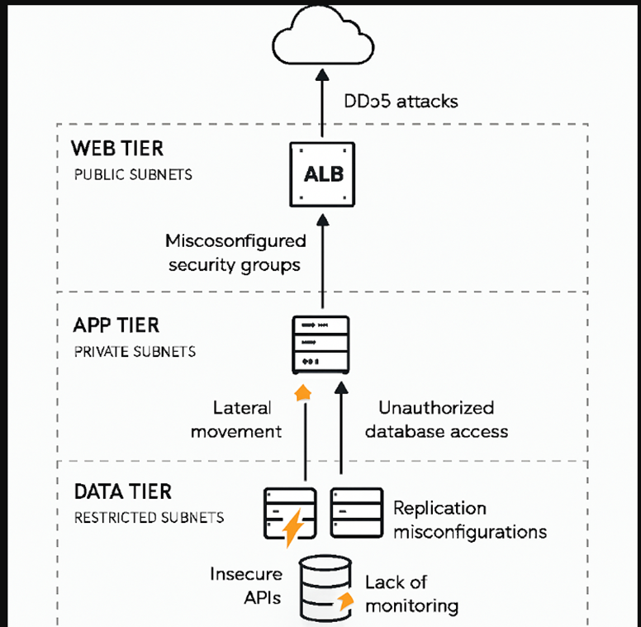
THREATS in SINGLE CLOUD NETWORK
threat analysis methods of a real cloud network
Stride
Attack Path Mapping /Layered Threat Modelling
Attack Surface Enumeration/ Automated Configuration Auditing
Simulation & Penetration Testing
Monitoring & Logging

Slide 8
case examples of THREATS Materialized
Web Tier
(Public Subnets)
Capital One AWS Breach (2019)
A Web Application Firewall (WAF) misconfiguration enabled an ServerS ide Request Forgery (SSRF) attack, exposing sensitive data from the public-facing tier.
App Tier
(Private Subnets)
Tesla Kubernetes Console Exposure (2018)
An unsecured Kubernetes admin console in a private subnet allowed attackers to deploy cryptojacking workloads and move laterally into Tesla’s application tier.
Cross Tier Movement
Verizon AWS S3 Leak (2017)
Misconfigured S3 permissions enabled lateral movement from log files to sensitive customer data
Data Tier
(Restricted Subnets)
MongoDB Cloud Exposures (2017)
The exposure of thousands of misconfigured MongoDB instances within cloud VPCs resulted in large-scale data theft and widespread ransom extortion

Slide 9

Thank you
-Team ROOTSHELLL

